Slide 1

LOTR Ring architecture MULTI CORE FABRIC WITH FPGA synthesizability AND VGA DISPLAY
Adi Levy
Saar Kadosh
Adviser: Amichai Ben-David (NVIDIA)
Notes:
שלום אני עדי וסער כאן איתי ואנחנו רוצים להציג בפניכם את הפרויקט שלנו לוטר. לורד אוף דה רינג ארכיטקטורה ודיזיין של מעבד מרובה ליבות בטופולוגיית רינג, עם יכולות להיטען על אפג'איי ולהפוך אותו למעבד מרובה ליבות שמריץ קוד ותצוגה. ומסך
הפרויקט הוא המשך ישיר לפרויקט הקודם שלנו

Slide 2
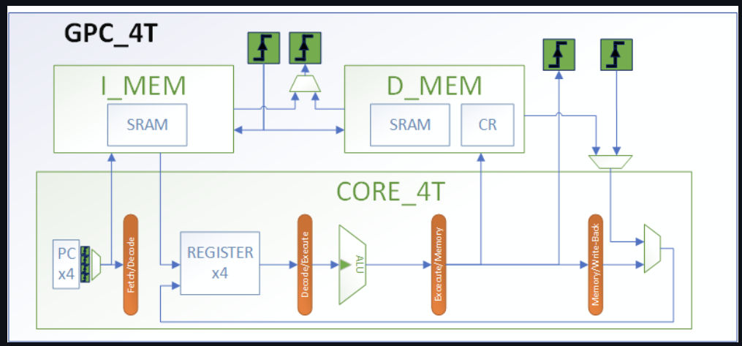
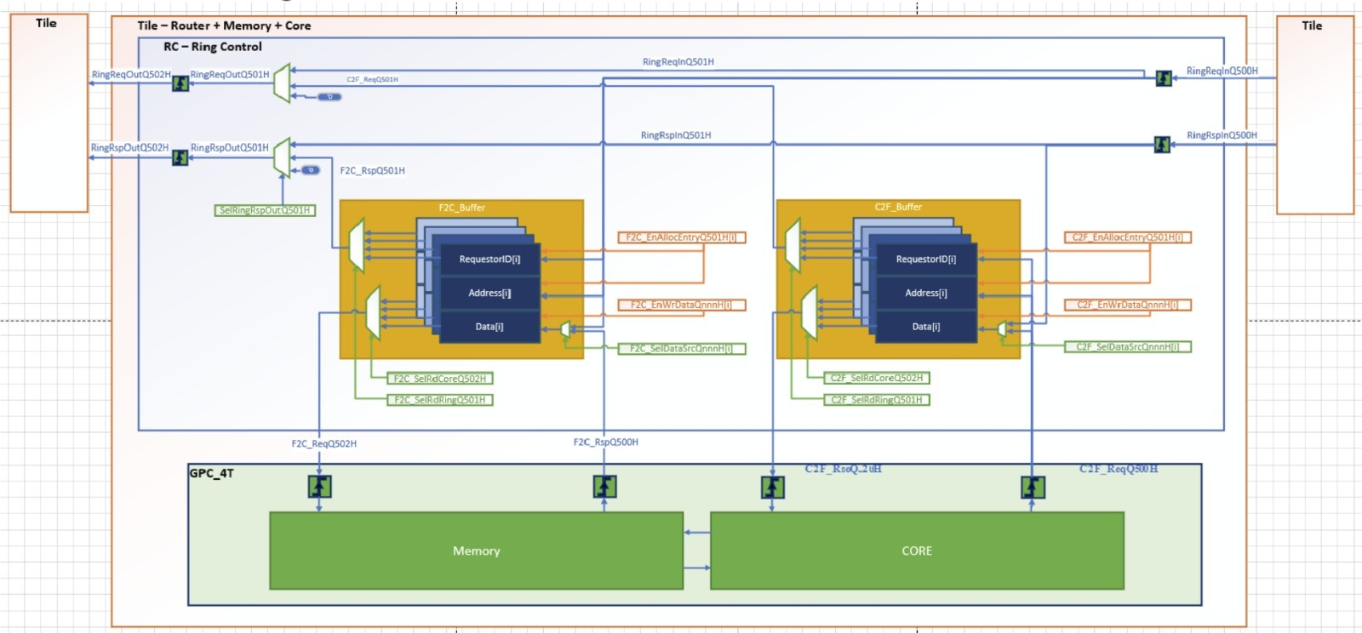
Introduction
Reminder
GPC_4T – 5 Stage, RV32I compatible, 4 Threads
RC – ring controller.
Notes:
GPC
5 stage
RV32I ISA compatible
4 Thread, fine grain,
Core IPC ~1 , Thread IPC is ¼
Parametrized memory Size, Tested on 4KB I_MEM + 4KB D_MEM
No Cache – all memory is on die, Physical memory same as Virtual memory.
RC
Arbitration logic for Core & Fabric transactions
Solves Ordering, Starvation, deadlock, coherency,
מבטיח ששתי בקשות שיצאו מאותו המקור אל אותו היעד יגיעו בסדר הכרונולוגי
בקשת קריאה לא תעקוף בקשת כתיבה אם היא יצאה לפניה

Slide 3
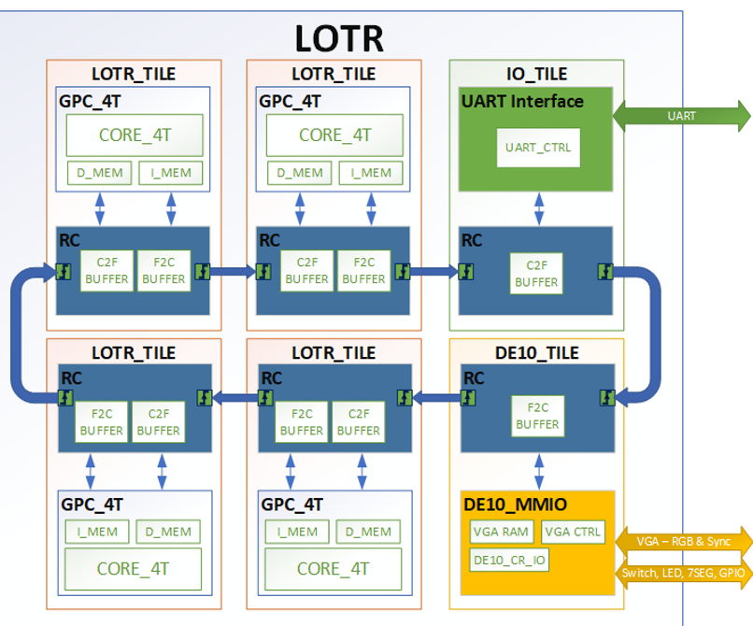
Introduction
LOTR - Main Idea
Multi Core SOC
Ring architecture fabric
FPGA loadable design
Compatible with FPGA IO:
VGA, Switch, Button
Programable in high level language. (C)
Runs many Threads simultaneously to accelerate distributed computation.

Slide 4
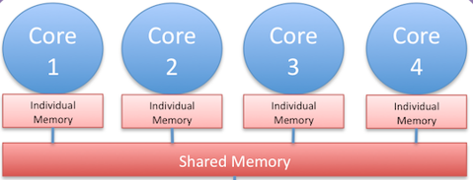
GENERAL DESCRIPTION
Multicore Processor
Notes:
- Traditionally, to run multiple processes, need “context switch” to allow the same “core/thread” to run different programs simultaneously.
- Improves IPC of the System when it runs multiple processes.
- Typically this interduces the complexity of cache coherency.

Slide 5

GENERAL DESCRIPTION
Ring Architecture
Notes:
פותרים את בעיית הקוהירנסי באמצעות ארכיטקטורת רינג המאפשרת שמירה על אורדרינג ובאמצעות שימוש בממורי מאפ – ולא קאש.

Slide 6
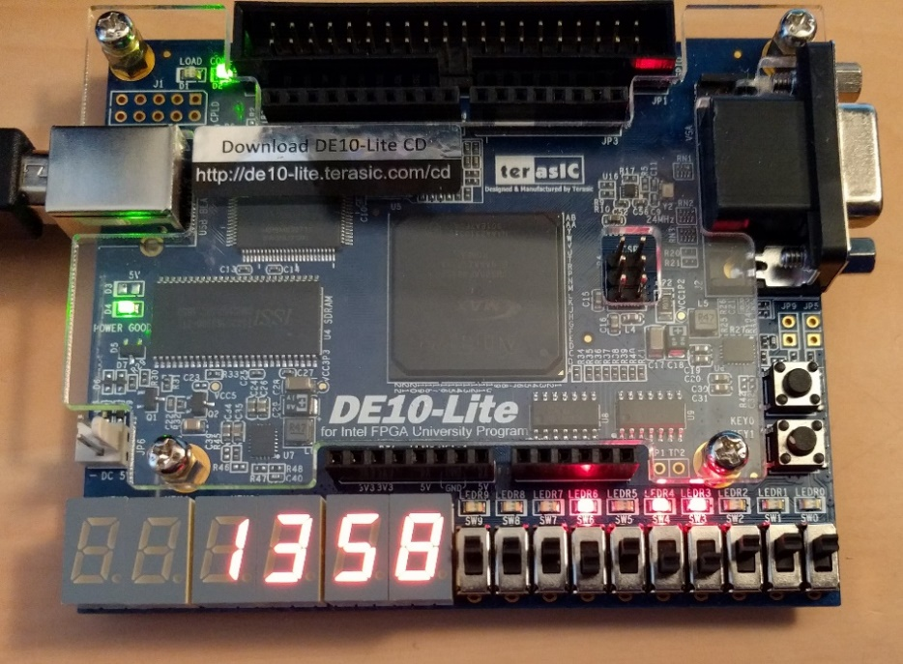
GENERAL DESCRIPTION
FPGA
Notes:
כל ה אי/או של האפפיג'יאי ממופה לכתובת זיכרון. MMIO.

Slide 7

GENERAL DESCRIPTION
VGA

Slide 8
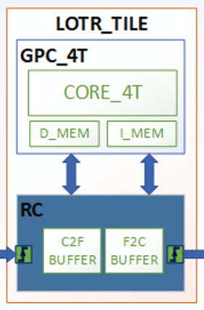
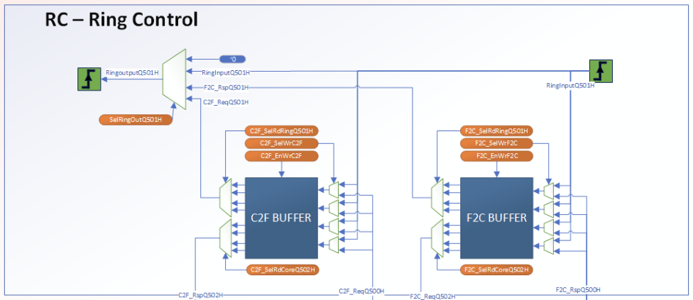
DESIGN BUILDING BLOCKS
Tile: basic building block of the LOTR.
Notes:
GPC_4T + RC. -> Will create the Tile
Multiple Tiles will join to create the LOTR RING. Using Standard IO Interface.
Each tile has its own ID, starting from 1.

Slide 9
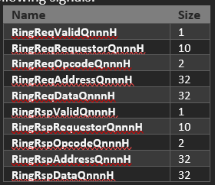
DESIGN BUILDING BLOCKS
Ring: Network topology of how each Tile connects with the others.
Each Tile is assigned with a set of signals.
Symmetrical input & output.
Last Tile is assigned to the first Tile to complete the Ring structure.
Notes:
הכניסות והיציאות סימטריות . סטנדרט אינטרפייס

Slide 10
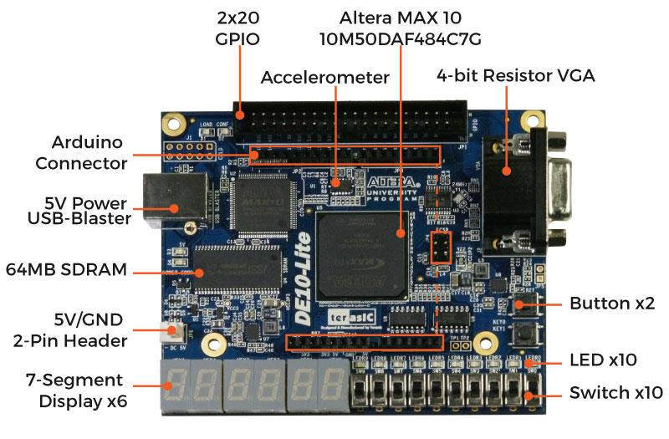
DESIGN BUILDING BLOCKS
FPGA Integration:
FPGA Kit DE10-Lite
Quartus Prime development tool
Notes:
VGA
Button
Switch
LED
Arudino Digital IO

Slide 11
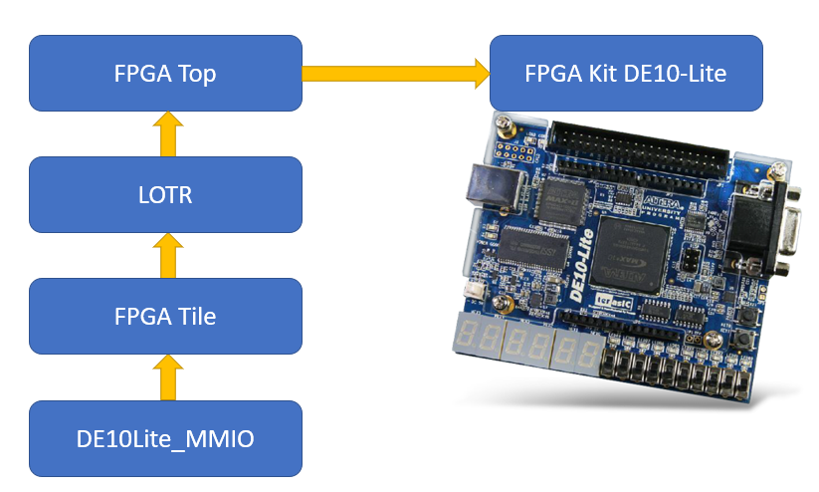
DESIGN BUILDING BLOCKS
FPGA Integration:
FPGA Modules Hierarchy

Slide 12
DESIGN BUILDING BLOCKS
FPGA Integration:
DE10Lite_MMIO module:
Contains the VGA RTL controller & memory
Has F2C connections. (Fabric to “Core”)
Communicate with the FPGA kit I\O using CR MMIO.
The CR is accessible as “regular” Load/Store operation from Any Thread.
Notes:
No need to have the C2F due to the nature of the Tile which cannot generate traffic on the ring

Slide 13
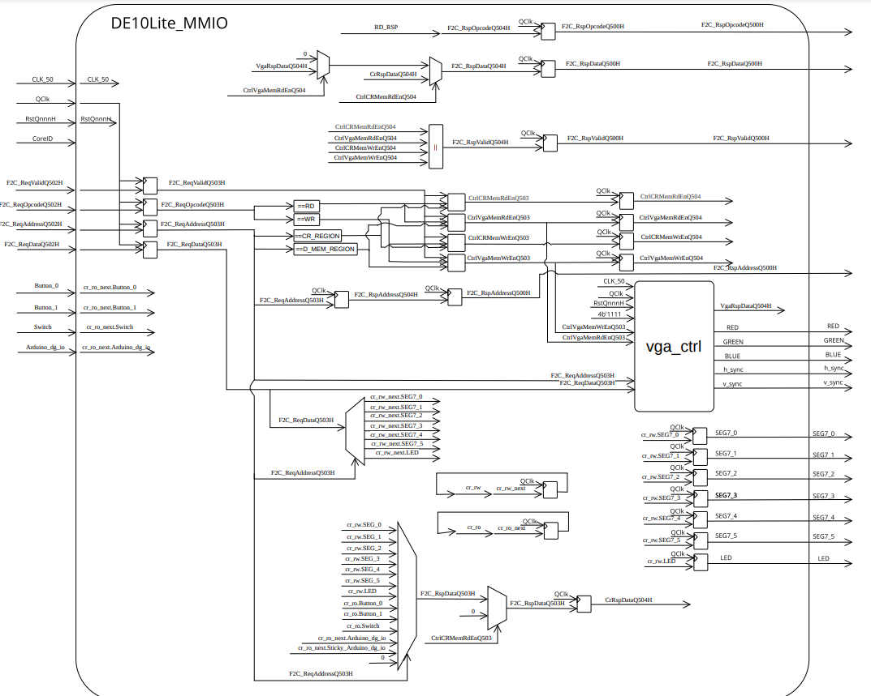
DESIGN BUILDING BLOCKS
F2C Interface
F2C Interface
VGA
FPGA MMIO CR

Slide 14
DESIGN BUILDING BLOCKS
FPGA Integration:
FPGA CRs (Control Registers):
Offset | Name | Type | Description | Structure
2000 | CR_SEG7_0 | RW | Hold data pass to 7 segment 0 | [7:0]
2004 | CR_SEG7_1 | RW | Hold data pass to 7 segment 1 | [7:0]
2008 | CR_SEG7_2 | RW | Hold data pass to 7 segment 2 | [7:0]
200c | CR_SEG7_3 | RW | Hold data pass to 7 segment 3 | [7:0]
2010 | CR_SEG7_4 | RW | Hold data pass to 7 segment 4 | [7:0]
2014 | CR_SEG7_5 | RW | Hold data pass to 7 segment 5 | [7:0]
2018 | CR_LED | RW | Hold data pass to FPGA kit LEDs | [9:0]
201c | CR_Button_0 | RO | Hold value of the kit's button 0
2020 | CR_Button_1 | RO | Hold value of the kit's button 1
2024 | CR_Switch | RO | Hold value of the kit's 10 switches | [9:0]
2028 | CR_Arduino_dg_io | RW | Arduino interface | [15:0]
202C | CR_Sticky_Arduino_dg_io | RW | Arduino interface
Notes:
The CR Sticky is for “polling” sampling due to not having interrupt support.

Slide 15
DESIGN BUILDING BLOCKS
DE10Lite_MMIO Example:
Core writes to LED address 0x03C02018 The value 0x5
The Core D_MEM identifies the request as “non-local” and sends it to the Ring Controller.
RC will pass the store request though the RING until it reaches the DE10_MMIO tile.
The data will be writing to the LED CR
LED Turns on
#define LED_FGPA ((volatile int *) (0x03C02018))
*LED_FGPA = 0x5;

Slide 16
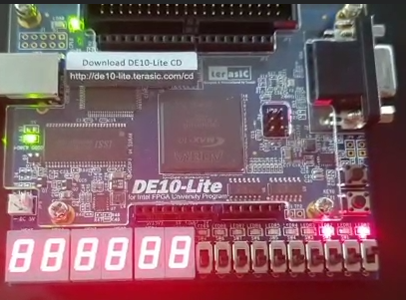
DESIGN BUILDING BLOCKS
DE10Lite_MMIO Example:
LED turn on with the number 0x5 (101)

Slide 17
DESIGN BUILDING BLOCKS
Memory :
Two 8KB SRAM for each core
32 bit words, Little Endian method.
virtual and physical memory addressing.
Physical address of each byte is 32 bits in a designated pattern:
SoC level: Address must contain non-zero 8 MS bits, indicating of the Core ID.
Core level: Address have zero on bits 31:24, indicating it’s a virtual address for this local memory regions.
Example: for Core 3, 0x03010001 == 0x00010001
Core ID | Region | Reserved | Memory Offset
Address[31:24] | Address[23:22] | Address[21:14] | Address[11:0]
Notes:
In the SW we write in C, we can simply access Physical memory using volatile address. The Stack, Instruction, Data etc will always be “virtual” unless explicitly allocating physical address

Slide 18
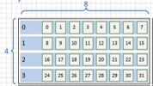
DESIGN BUILDING BLOCKS
VGA
640x480 resolution
Screen divided into chunks : 4x8 pixels, each pixel is a bit.
Each chunk contains 4 bytes

Slide 19
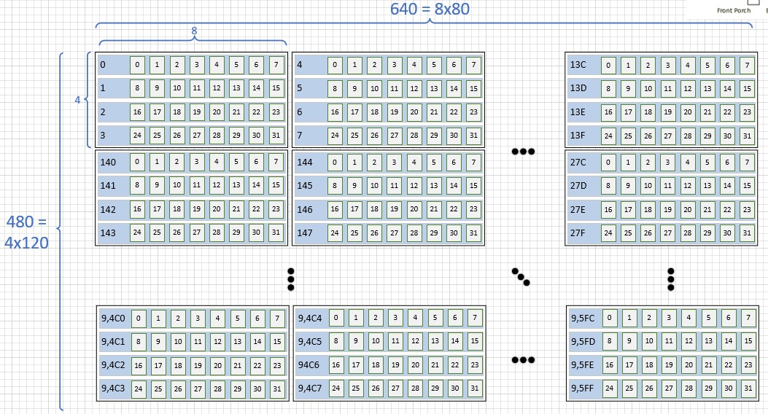
DESIGN BUILDING BLOCKS
VGA
Overall 80x120=9600 blocks\words
VGA monitor simplified as a 32Kb memory .

Slide 20
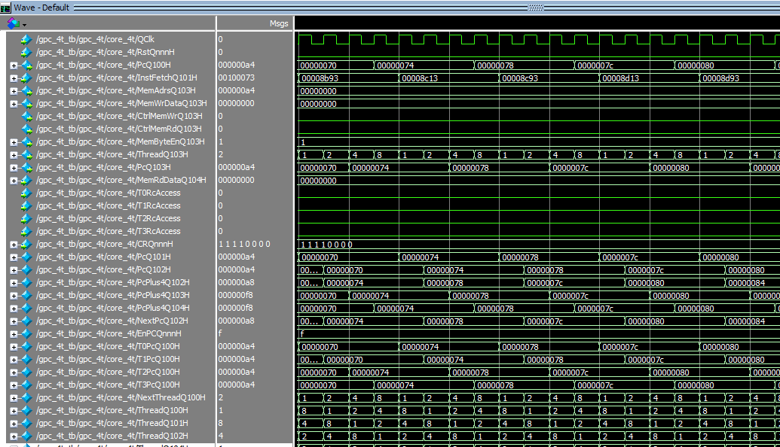
VALIDATION PLAN
Simulation Test Bench: SV test bench created to simulate the design using ModelSim.
Same as GPC_4T
Back door Memory loading from a file.
instance of LOTR module with 2 LOTR Tiles, and 1 FPGA tile.
Logs
Notes:
נעבור לתוכנית הולידציה
בפרויקט הקודם כתבנו תוכנית ולידציה מסודרת מאוד. מהרגע שכותבים קוד בשפת סי ועד הרצה של סימולציה של המעבד עם התוכנית
השתמשנו בטסט בנץ' מאוד דומה גם הפעם

Slide 21
VALIDATION PLAN
Alive Multi Core:
thread 0 of core 1 WR to thread 0 of core 2 and later read:
#define SCRATCHPAD_CORE_2 ((volatile int *) (0x02400900))
int main() {
int ThreadId = CR_THREAD[0];
int UniqeId = CR_WHO_AM_I[0];
int counter = 0 ;
switch (UniqeId){ //the CR Address return Core & Thread ID
case 0x4 : // This is Core 1, Thread 0
SCRATCHPAD_CORE_2[0] = 0x51; //Writing to Core2 Memory
MEMORY[0] = SCRATCHPAD_CORE_2[0]; //Reading from core 2
break;
Notes:
השלב הראשון בתוכנית הולידציה החדשה שלנו.
פרוף אוף קונספט לתוכנית מרובת ליבות
אלייב מולטי קור
תוכנית פשוטה מאוד של כתיבה וקריאה מזיכרון של קור אחר

Slide 22
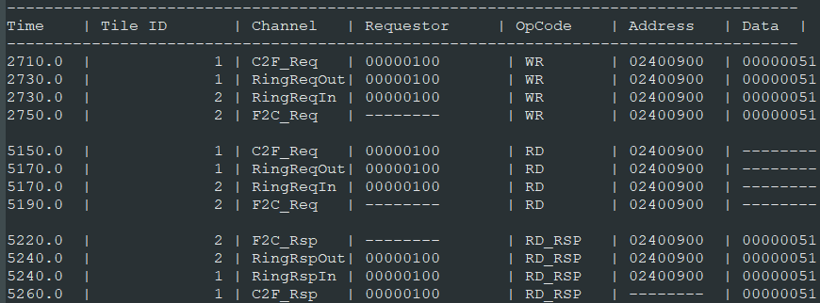
VALIDATION PLAN
RC Log:
Notes:
לתאר את הלוג
קיבלנו פרוף אוף קונספט למעבד מרובה ליבות
היו לנו הרבה בעיות עם זה בגלל המנגנון החומרתי שמקפיא

Slide 23
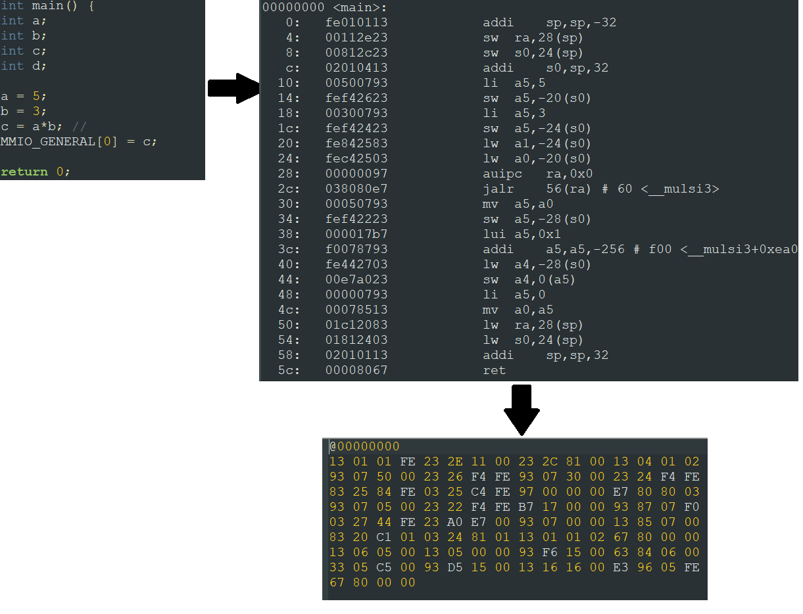
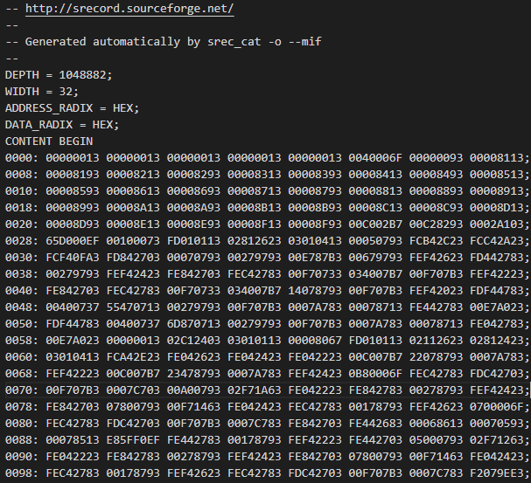
VALIDATION PLAN
MIF (Memory Initialization File):
Quartus Prime use MIF to load as an initial memory to FPGA
We created MIF with scripts that parc the GCC outputs:
Final stage on GPC_4T project
New Stage
Notes:
נעבור לשלב הבא וזה לטעון על אפג'איי
מושג חשוב שנכיר

Slide 24
VALIDATION PLAN
MIF file:

Slide 25
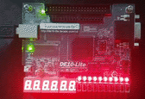
VALIDATION PLAN
Alive FPGA Led Counter: checking PoC for the FPGA kit
Turn the FPGA LEDs on/off using software.
write increasing numbers to the CR of the MMIO tile that pass the data to the FPGA kit.
The numbers are binary represented on the LEDS.

Slide 26
VALIDATION PLAN
Alive VGA & VGA log:
VGA display function as a memory: VGA modules hold the VGA memory and transferred it to the FPGA kit and from there to the monitor.
Writing 0xffffffff on a diagonal 2 dimensional array.
VGA log will generate a snapshot of the VGA memory.
Notes:
לפני שחיברנו את הכבל. הדפסנו סנפשוט של הזיכרון

Slide 27
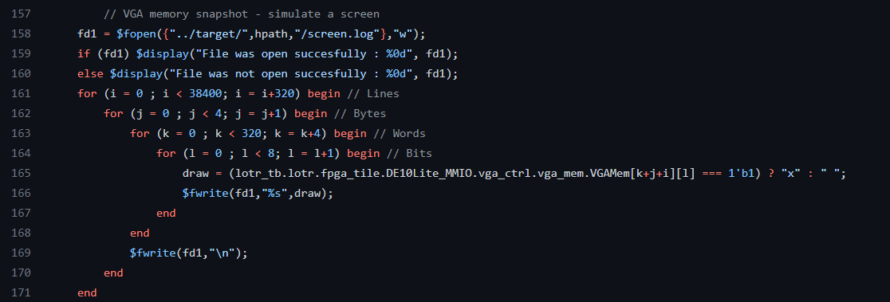

VALIDATION PLAN

Slide 28
VALIDATION PLAN
Alive VGA & VGA log:
Test 2: Connect VGA monitor and print to it.
Using a library of print functions from Bar-Ilan university.
VGA display test that writes a text to a monitor.

Slide 29
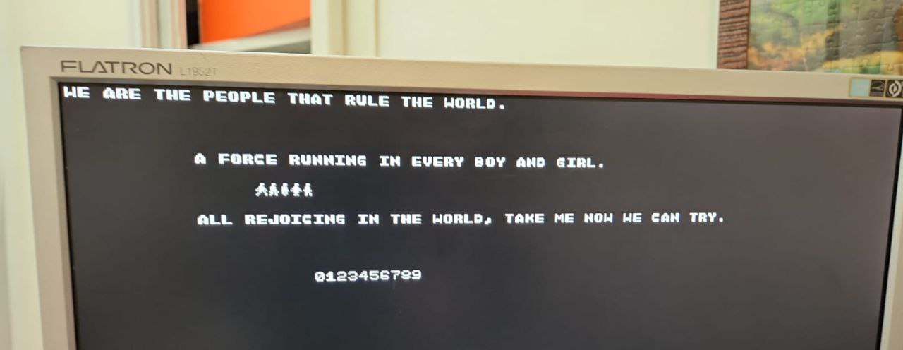
VALIDATION PLAN
#include "graphic.h"
int main() {
int UniqeId = CR_WHO_AM_I[0];
switch (UniqeId) { //the CR Address
case 0x4 : // Core 1 Thread 0
rvc_printf("WE ARE THE PEOPLE THAT RULE THE WORLD.\n");
draw_symbol(0, 15, 15);
draw_symbol(1, 15, 16);
draw_symbol(2, 15, 17);
draw_symbol(3, 15, 18);
draw_symbol(4, 15, 19);
case 0x5 : // Core 1 Thread 1
set_cursor(10,0);
rvc_printf("A FORCE RUNNING IN EVERY BOY AND GIRL.\n");
case 0x6 : // Core 1 Thread 2
set_cursor(20,0);
rvc_printf("ALL REJOICING IN THE WORLD, TAKE ME NOW WE CAN TRY.\n");
case 0x7 : // Core 1 Thread 3
set_cursor(30,0);
rvc_printf("0123456789\n");
case 0x8 : // Core 2 Thread 0
draw_symbol(0, 10, 15);
draw_symbol(1, 10, 16);
draw_symbol(2, 10, 17);
draw_symbol(3, 10, 18);
draw_symbol(4, 10, 19);
default :
while(1);
break;
}// case
return 0;
}

Slide 30
Example: MC Multitask – 2 Cores, 8 Threads

Slide 31
Example: MC Multitask
Core 1:
thread 0: sorting array located on thread 0 core 2.
thread 1: loading an array to be sorted to core 1 shared memory.
thread 2: loading 2 matrices and multipling to core 1 shared memory.
Core 2:
thread 0: loading an array to be sorted to core 2 shared memory.
thread 1: sorting array located on core 1 shared memory.
thread 2: multiplies matrices located on core 1 shared memory.

Slide 32
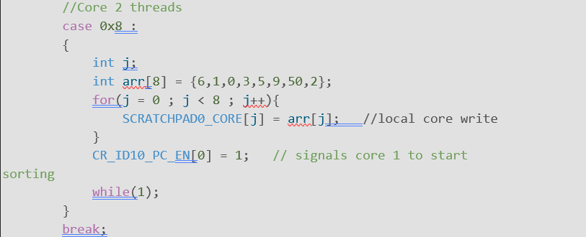
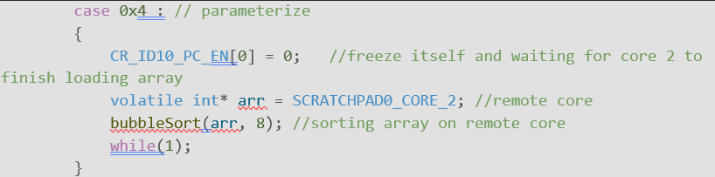
Example: MC Multitask
Program snippets:

Slide 33
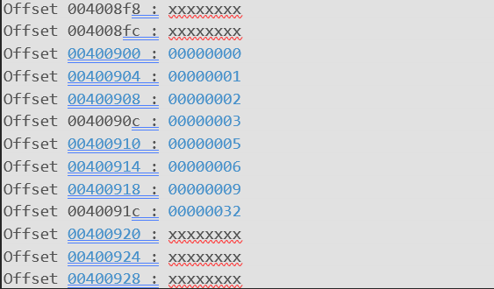
Example: MC Multitask
Core 2 sorted array:

Slide 34
Example: LED Blink – FPGA kit LED controlled by switches state

Slide 35

Example: LED Blink
Infinite loop. read the state of the switches on the FPGA kit.
Switches state:
000 : All LEDs blink.
001 : Binary counter.
010 : One LED moving left - power of 2 counter.
011 : Decrease binary counter ( starts from $2^{10}$).
100 : One LED moving right - power of 2 decreasing counter, from $2^{9}$.
101 : 7 SEG counter.

Slide 36
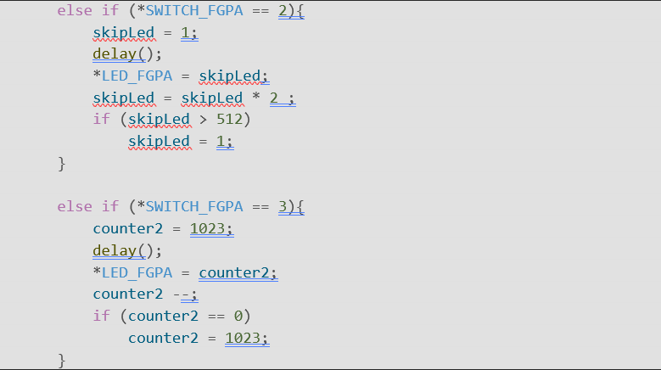
Example: LED Blink
Program snippets:

Slide 37
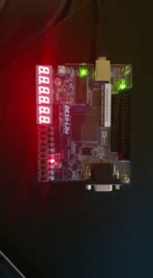
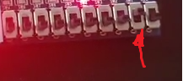
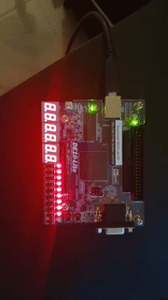
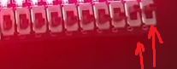
Example: LED Blink
010 : One LED moving left:
011 : Decrease binary counter:

Slide 38
Example: Snake – Interactive Game

Slide 39
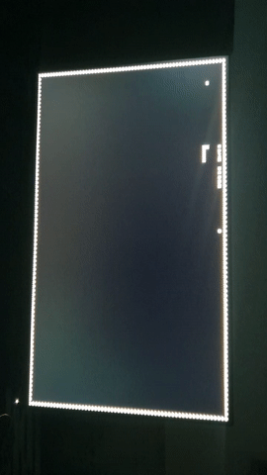
Example: Snake
Designed by our advisor Amichai. Controlled by an FPGA interface.

Slide 40
Example: Sorting VGA - a graphical 8 thread array sorting

Slide 41
Example: Sorting VGA
Method: Each pair of thread perform a sorting algorithm on the same dataset.
Bubble Sort, Insertion Sort.
graphic interface, the screen is divided into 8 parts.
Each number from an array is visualized as a vertical rectangle.
Each swap the location of each rectangle is cleaned, and the new swapped rectangle is drawn.

Slide 42
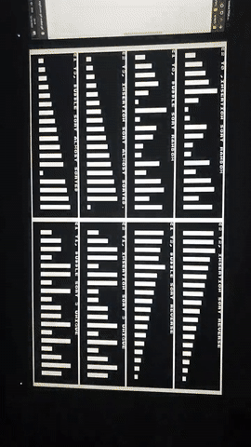
Example: Sorting VGA
Notes:
שוב מזכיר. זה קוד פשוט בשפת סי שרץ על הדיזיין שלנו שעל האפג'יאיי
רואים כאן למשל באבל סורט

Slide 43
Example: FPGA main – complete all-around program

Slide 44
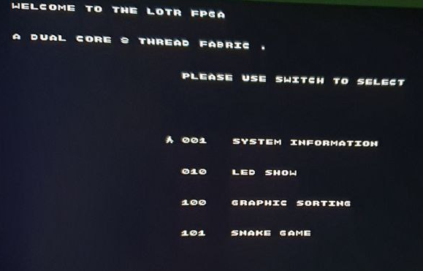
Example: FPGA main
Main program that will include most of the other programs.
Menu
Select using switch

Slide 45
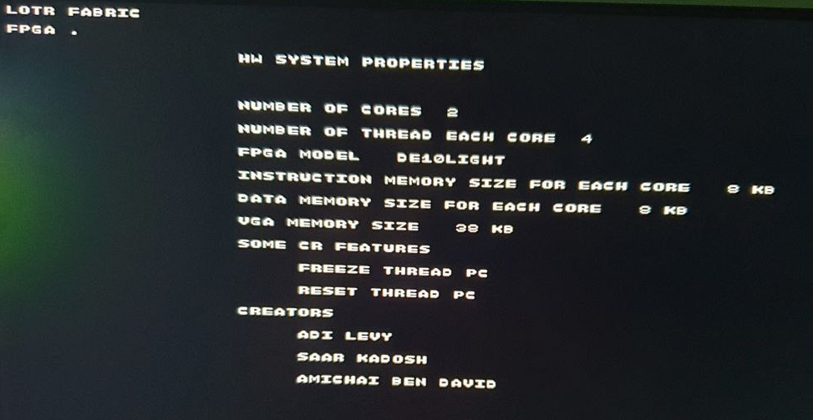
Example: FPGA main
System info:

Slide 46
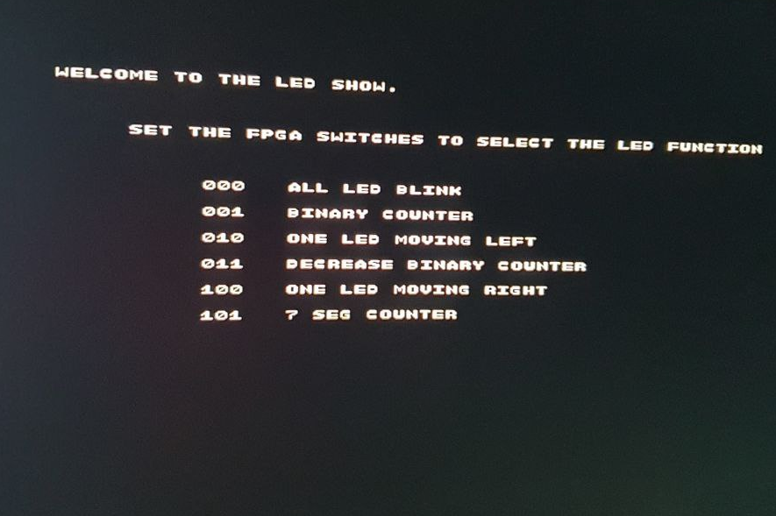
Example: FPGA main
LED show (LED blink):

Slide 47
Development & Methodologies

Slide 48
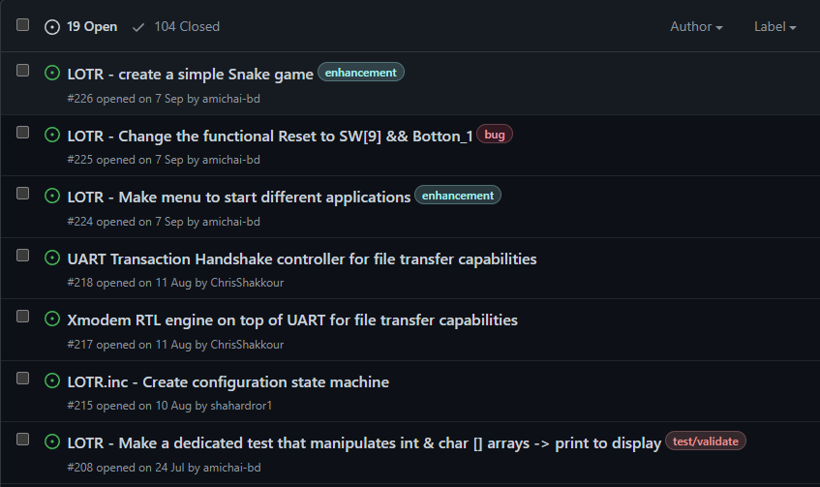
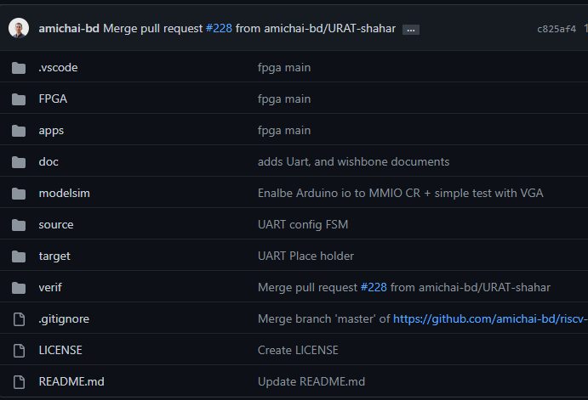
Development & Methodologies
Git & Repository:
Same GitHub repository from GPC_4T

Slide 49






Development & Methodologies

Slide 50

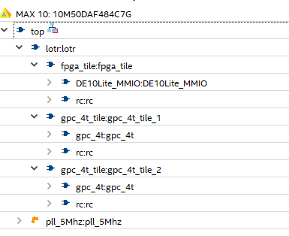
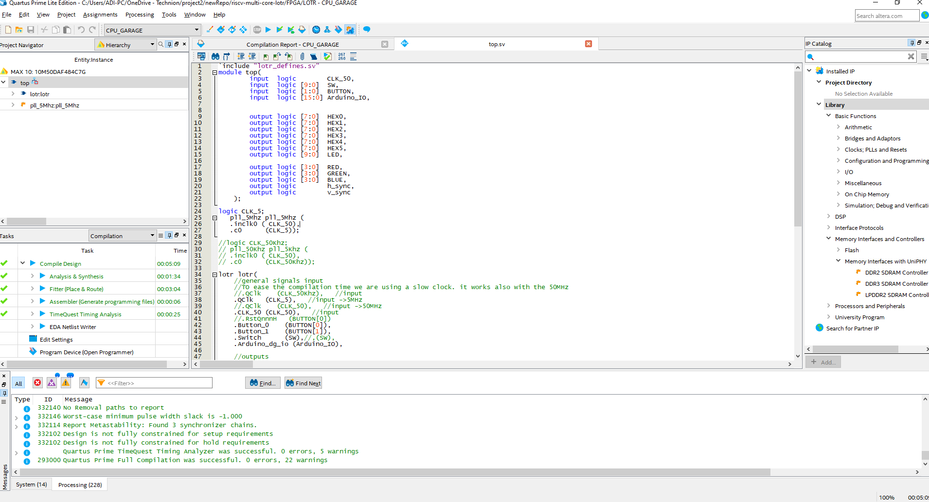
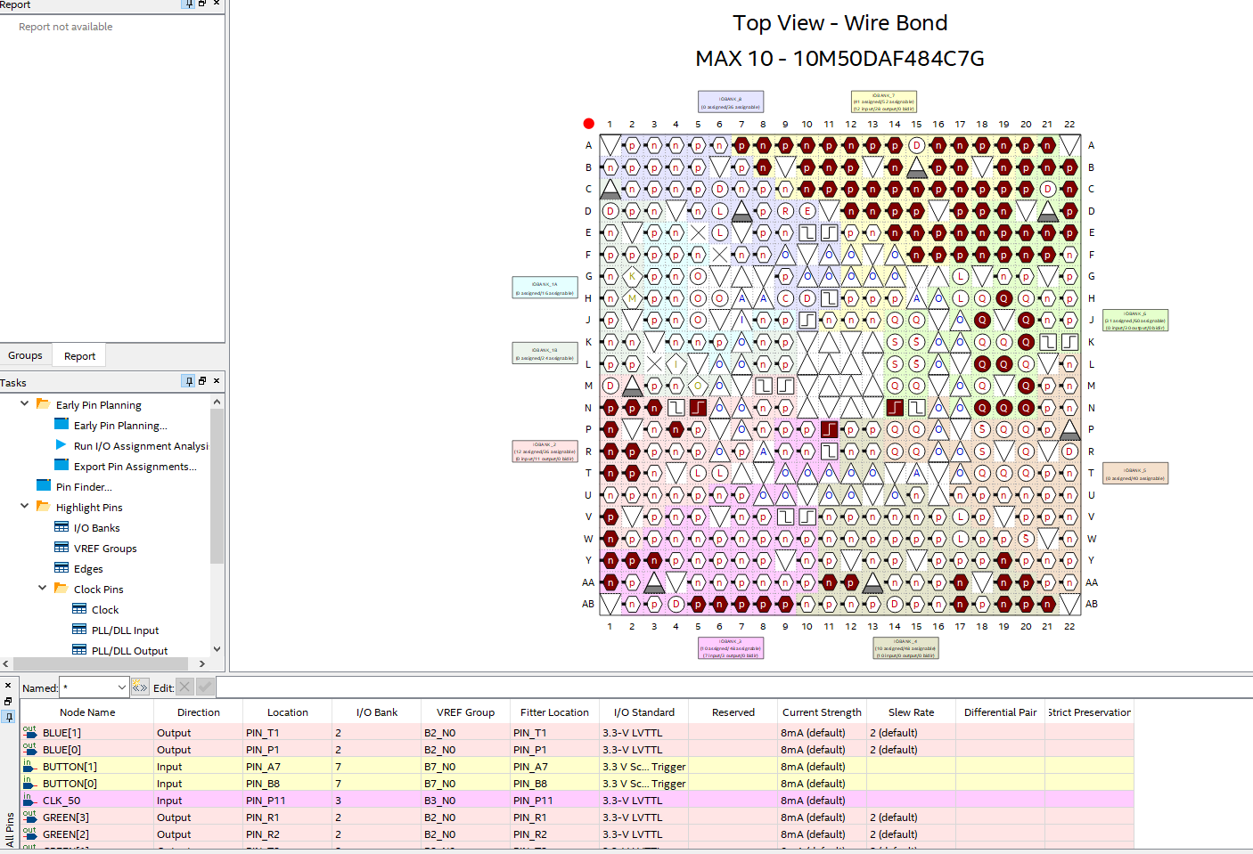
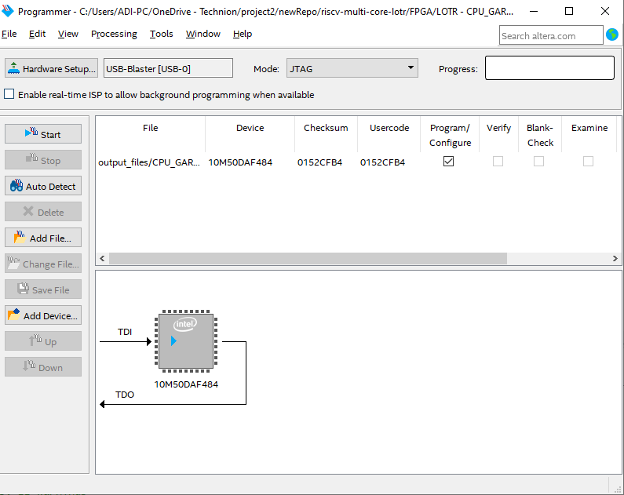
Development & Methodologies
Intel Quartus Prime:

Slide 51
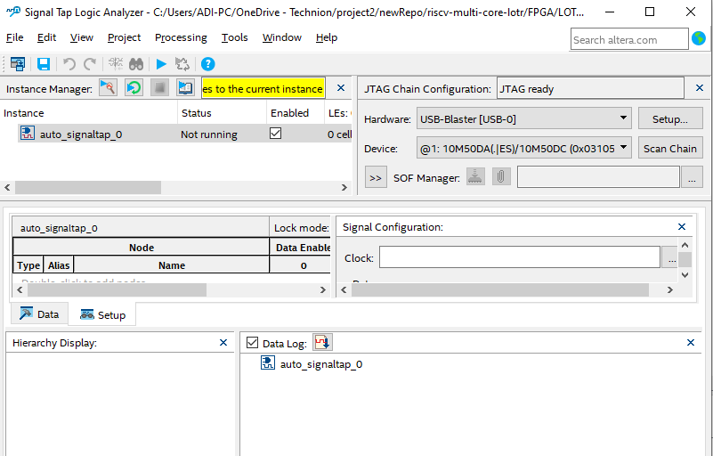
Development & Methodologies
Intel Quartus Prime:
Signal Tap: Used to detect bugs: why LEDS are not toggling as planed.

Slide 52
The End

Slide 53


Question?

Slide 54
DESIGN BUILDING BLOCKS
FPGA Integration:
PLL: Phase-locked loop used to regulate clock signals
Top level design works with 50Mhz clock frequency.
Some modules needs slower clock, so the PLL generates 5Mhz clock from the 50Mhz clock.

Slide 55
VALIDATION PLAN
Load Instruction and Data Memory:
Done manually.
Step 1: Using "gpc_compile_link.sh" script generate MIF file from C file
Step 2: Copy the content of the generated MIF file to the FPGA folder
Step 3: Full compilation from Quartus Prime.
Step 4: Program the files to the FPGA kit.

